Slide 2
Academics
ARCHITECTURE
Undergraduate
Bachelor of Architecture
Bachelor of Arts in Architecture
Graduate
Master of Architecture
Master of Architectural Studies
Master of Science in Architecture
Integrated Path to Architectural Licensure (IPAL)
DESIGN
Undergraduate
Bachelor of Arts in Product Design
Bachelor of Science in Graphic Design
& Interactive Media
Bachelor of Interior Architecture & Design
MINORS
Architecture
Construction Management
Digital Architecture & Fabrication (DAF)
Healthy Urbanism
Interior Architecture & Design
Graphic Design & Interactive Media
Product Design
CONSTRUCTION MANAGEMENT
Undergraduate
Bachelor of Science in Construction Management
Graduate
Master of Construction Management ONLINE
Notes:
We offer a wide range of both undergraduate and graduate degree programs in architecture, design, and construction management. The majority of our degrees are taken on our campus in San Diego, and our Master of Construction Management degree is a fully online program that can be completed from anywhere in the world.

Slide 3
Undergraduate
Bachelor of Architecture
Bachelor of Arts in Architecture
Graduate
Master of Architecture
Master of Architectural Studies
Master of Science in Architecture
Integrated Path to Architectural Licensure (IPAL)
Architecture
Architecture is now a
STEM APPROVED PROGRAM
Notes:
The School of Architecture at NewSchool is rich in diversity and creativity. With international faculty prominent in the field, our students are exposed to many different approaches to design and innovation and master the same industry standard technology in the classroom that is used in the workplace.
BACHELOR OF ARCHITECTURE
The 5-year, NAAB-accredited Bachelor of Architecture degree offers a curriculum that prepares students to become licensed architects. This program teaches both the fundamentals of the profession as well as the advanced theories and practical application of creating inspirational structures in a sustainable manner.
BACHELOR OF ARTS IN ARCHITECTURE
The 4-year Bachelor of Arts in Architecture degree is designed to allow career-focused students to enter the workforce as quickly as possible or to continue with their education by earning a Master of Architecture degree. With a curriculum focused on familiarizing students with innovations, products, and building forms, this bachelor’s degree program gives students a strong foundation of architectural design from a technical and aesthetic perspective while preparing them for their professional future.

Slide 4
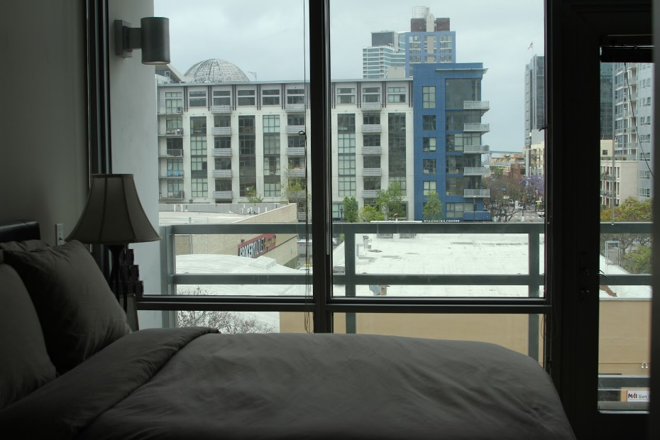
FULLY FURNISHED
WASHER & DRYER IN UNIT
RESIDENT ADVISOR
FITNESS CENTER
COURTYARD WITH FIRE PIT
UNDERGROUND PARKING
Student Housing
Urban residential life building one block from campus
Notes:
There is no better way to discover the vibrant design community of San Diego than to live here! Located just one block away from campus, Tenth and G Apartments offer a hip urban residential life opportunity for our students. The modern community features a top floor viewing deck of downtown San Diego, a private movie theater, state-of-the-art fitness facilities, large interior courtyard with fire pit, business tech center, and gated underground parking. It’s conveniently located in the heart of the East Village, within walking distance to public transportation, shopping, beaches, and San Diego’s vibrant nightlife.
Students residing in NewSchool housing units will enjoy fully furnished apartments with utilities and internet included, as well as the added benefit of a Resident Advisor available to assist them. Each furnished apartment has two bedrooms (accommodating four students), two bathrooms, a full kitchen, and a washer and dryer. Gated underground parking is available for an additional fee on a space-available basis.

Slide 5
Career Services Resources
Job Fairs & Company Information Seminars
Resume & Interview Prep Sessions
Mentor/Mentee Program
On-Campus Job Interviews & Networking Opportunities
Portfolio Classes
Part-Time Job & Alumni Blogs
Job Newsletter
GradShow
Professional Development Workshops
Career Services
Notes:
The NewSchool of Architecture & Design Career Services Office provides a holistic approach to career development which nurtures all students from the beginning of their education to the advancement of their architectural and design careers beyond graduation.
*Event Highlight*
GradShow:
GradShow is an exhibition showcasing thesis projects and final portfolios from our graduating classes. The annual event highlights the disciplines from the variety of programs offered at the NewSchool of Architecture & Design including architecture, construction management, design and digital media arts. The event typically features over 100 individual projects comprised of large-scale renderings, models and digital media highlighting the best work of each alumni being displayed.
Each year, the NewSchool’s Career Services team hosts this annual gathering and structures an Employers Only Event from 12 PM – 2:30 PM. This event provides companies and local press access to the talented individuals being exhibited at the GradShow. The private affair provides exposure and opportunity for intellectual engagement and dialogue in a reverse job fair-like atmosphere. Many individuals graduating from NewSchool have secured employment during this event and employers attending have benefited from being able to scout the next generation of innovative leaders in one convenient location.
The GradShow concludes the special day with a spectacular hosted celebration of accomplishment from 6 PM – 9 PM for our graduates, their families, friends and the community at NewSchool to enjoy and revel in their achievements.
89% JOB PLACEMENT RATE
In Field of Study or Related Field Within 6 Months of Graduation (2017-2018
Companies that employ our graduates include
Gensler
Carrier Johnson + Culture
Perkins+Will Global
Restoration Hardware
Turner Construction Company
Balfour Beatty
Bechtel
PCL Construction
…and more

Slide 6
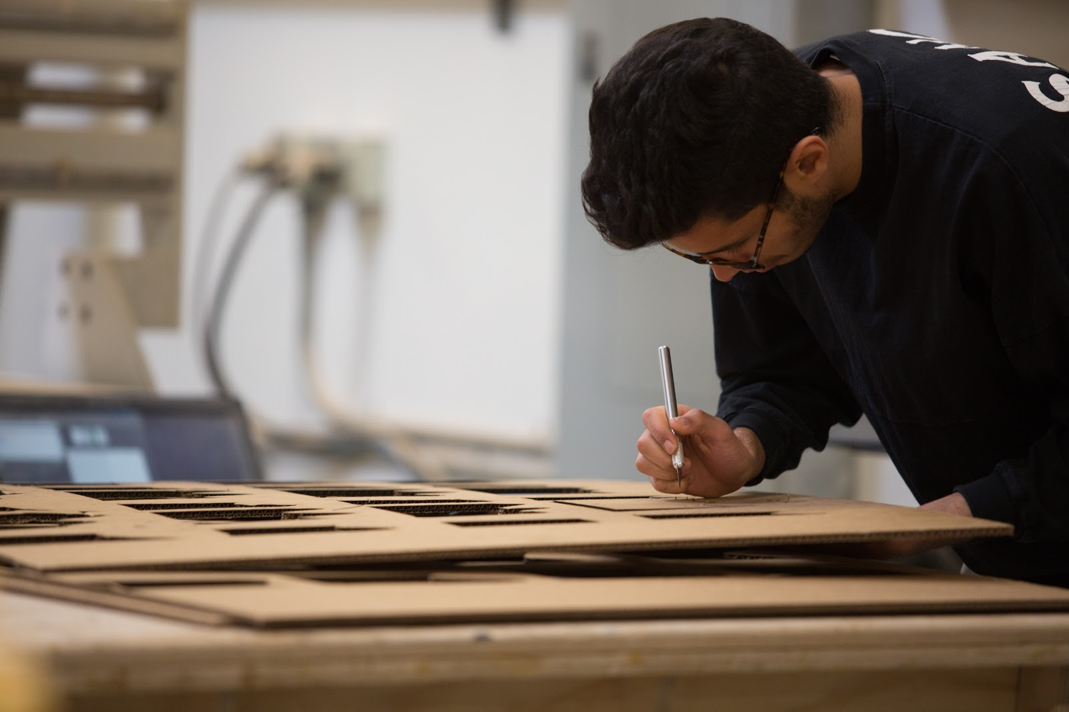
Financial Aid & Scholarships
Financial Aid
Free Application for Federal Student Aid (FAFSA)
Federal Work-Study
State Programs: Cal Grant A, Cal Grant B, California Dream Act
Military Benefits: Yellow Ribbon Program, Military Education Benefits
Private Education Loans
$1.6 MILLION
In Scholarships Awarded in 2018
Scholarships
NewSchool Fellows Award
President’s Award
Community College Discount
NewSchool Scholarship
Early Application Scholarship
Early Registration Scholarship
Opportunity Award
…and more
Notes:
The Office of Financial Aid can help you identify which scholarships you’re eligible to apply for, walk you through the application process, and recommend additional financial aid options.
We also have a team of Financial Aid Advisors who are committed to helping students through the financial aid process. We identify the best options for financial aid and scholarship opportunities and answer questions about the financial aid application process.

Slide 9
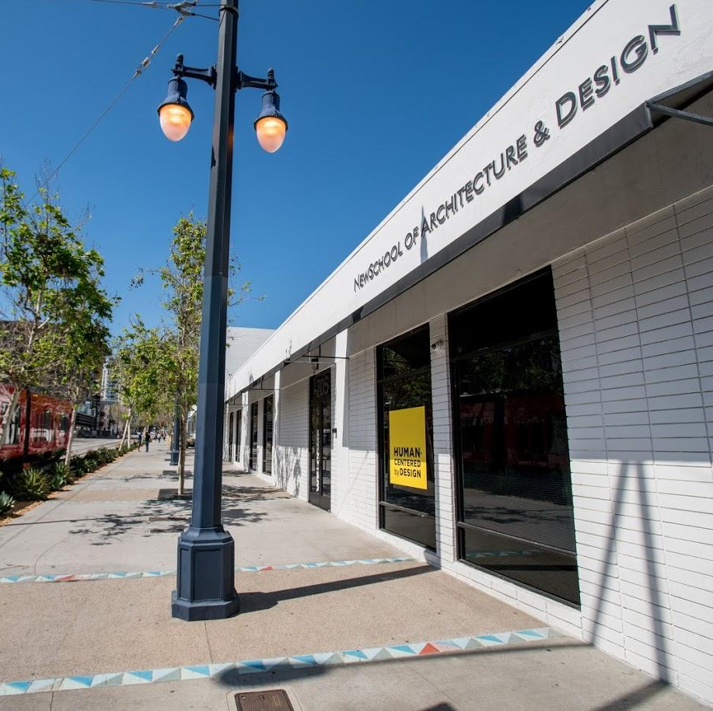
Adriana Detrinidad
adetrinidad@newschoolarch.edu
619-432-4694
Contact
Notes:
Applying to college doesn’t have to be daunting, especially with the help of an Enrollment Specialist. We have a friendly team of Enrollment Specialists who are here to help. Whether you’re about to start your application or you’re just interested in taking a tour and learning more about our programs, our Enrollment Team is a great resource.
How to Reach Us
Website
Social Media
Email
Phone
In-Person

