Slide 1

Paralegal Studies Orientation
Fall 2020

Slide 2
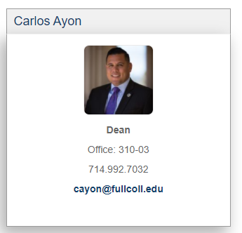
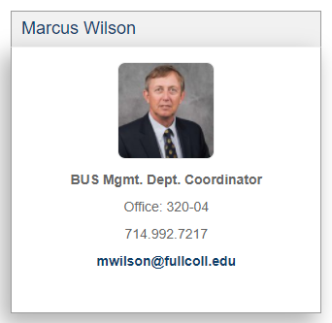
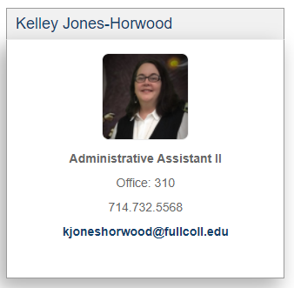
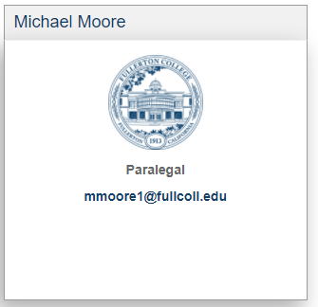
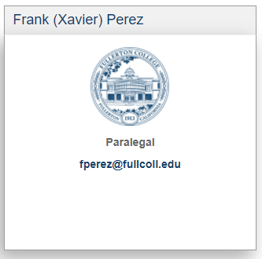
Program
Administration
Contacts

Slide 3
Program
Information
ABA approved since 1993
Associate’s and Certificate options
Continuing education pathways
Faculty and Administration are here to help you successfully complete the program.

Slide 4
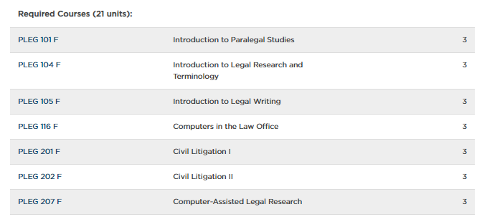
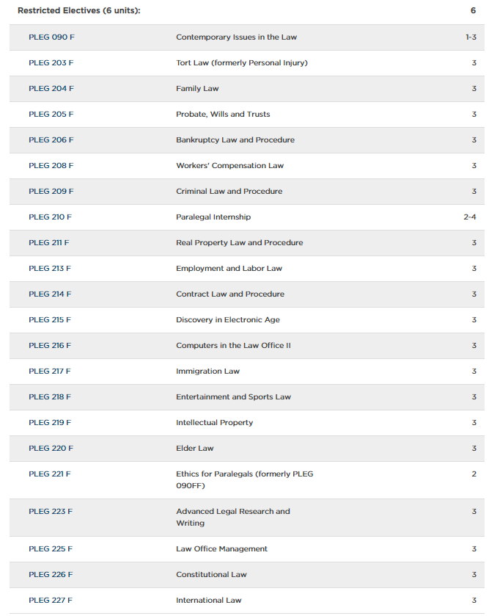
Paralegal Studies Curriculum
Grades of “C” or better
Required Coursework (21 units):
Restrictive Electives (6 units for A.S. Degree; 9 units for Cert.):

Slide 5
A.S. Degree vs. Certificate
What’s the Difference?
Certificate | A.S. Degree
Requires at least an Associate’s degree or higher from an accredited college or university | Requires the completion of the A.S. Paralegal Studies General Education Pattern* Link to PLEG GE Pattern: https://catalog.nocccd.edu/fullerton-college/academic-requirements/paralegal-studies-general-education/
Requires 9 units of Restrictive Electives | Requires 6 units of Restrictive Electives
Requires a total of 30 units | Requires a total of 60 units (27 units of coursework in the major)
*The A.S. degree requires a General Education evaluation
Notes:
If you are working towards an A.S. in Paralegal Studies, then you may earn the degree and the certificate at the same time.

Slide 6
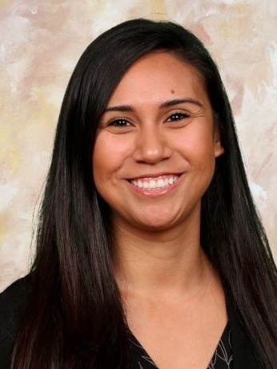
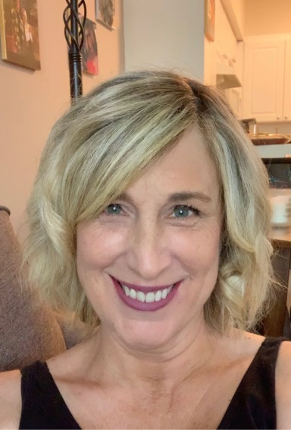
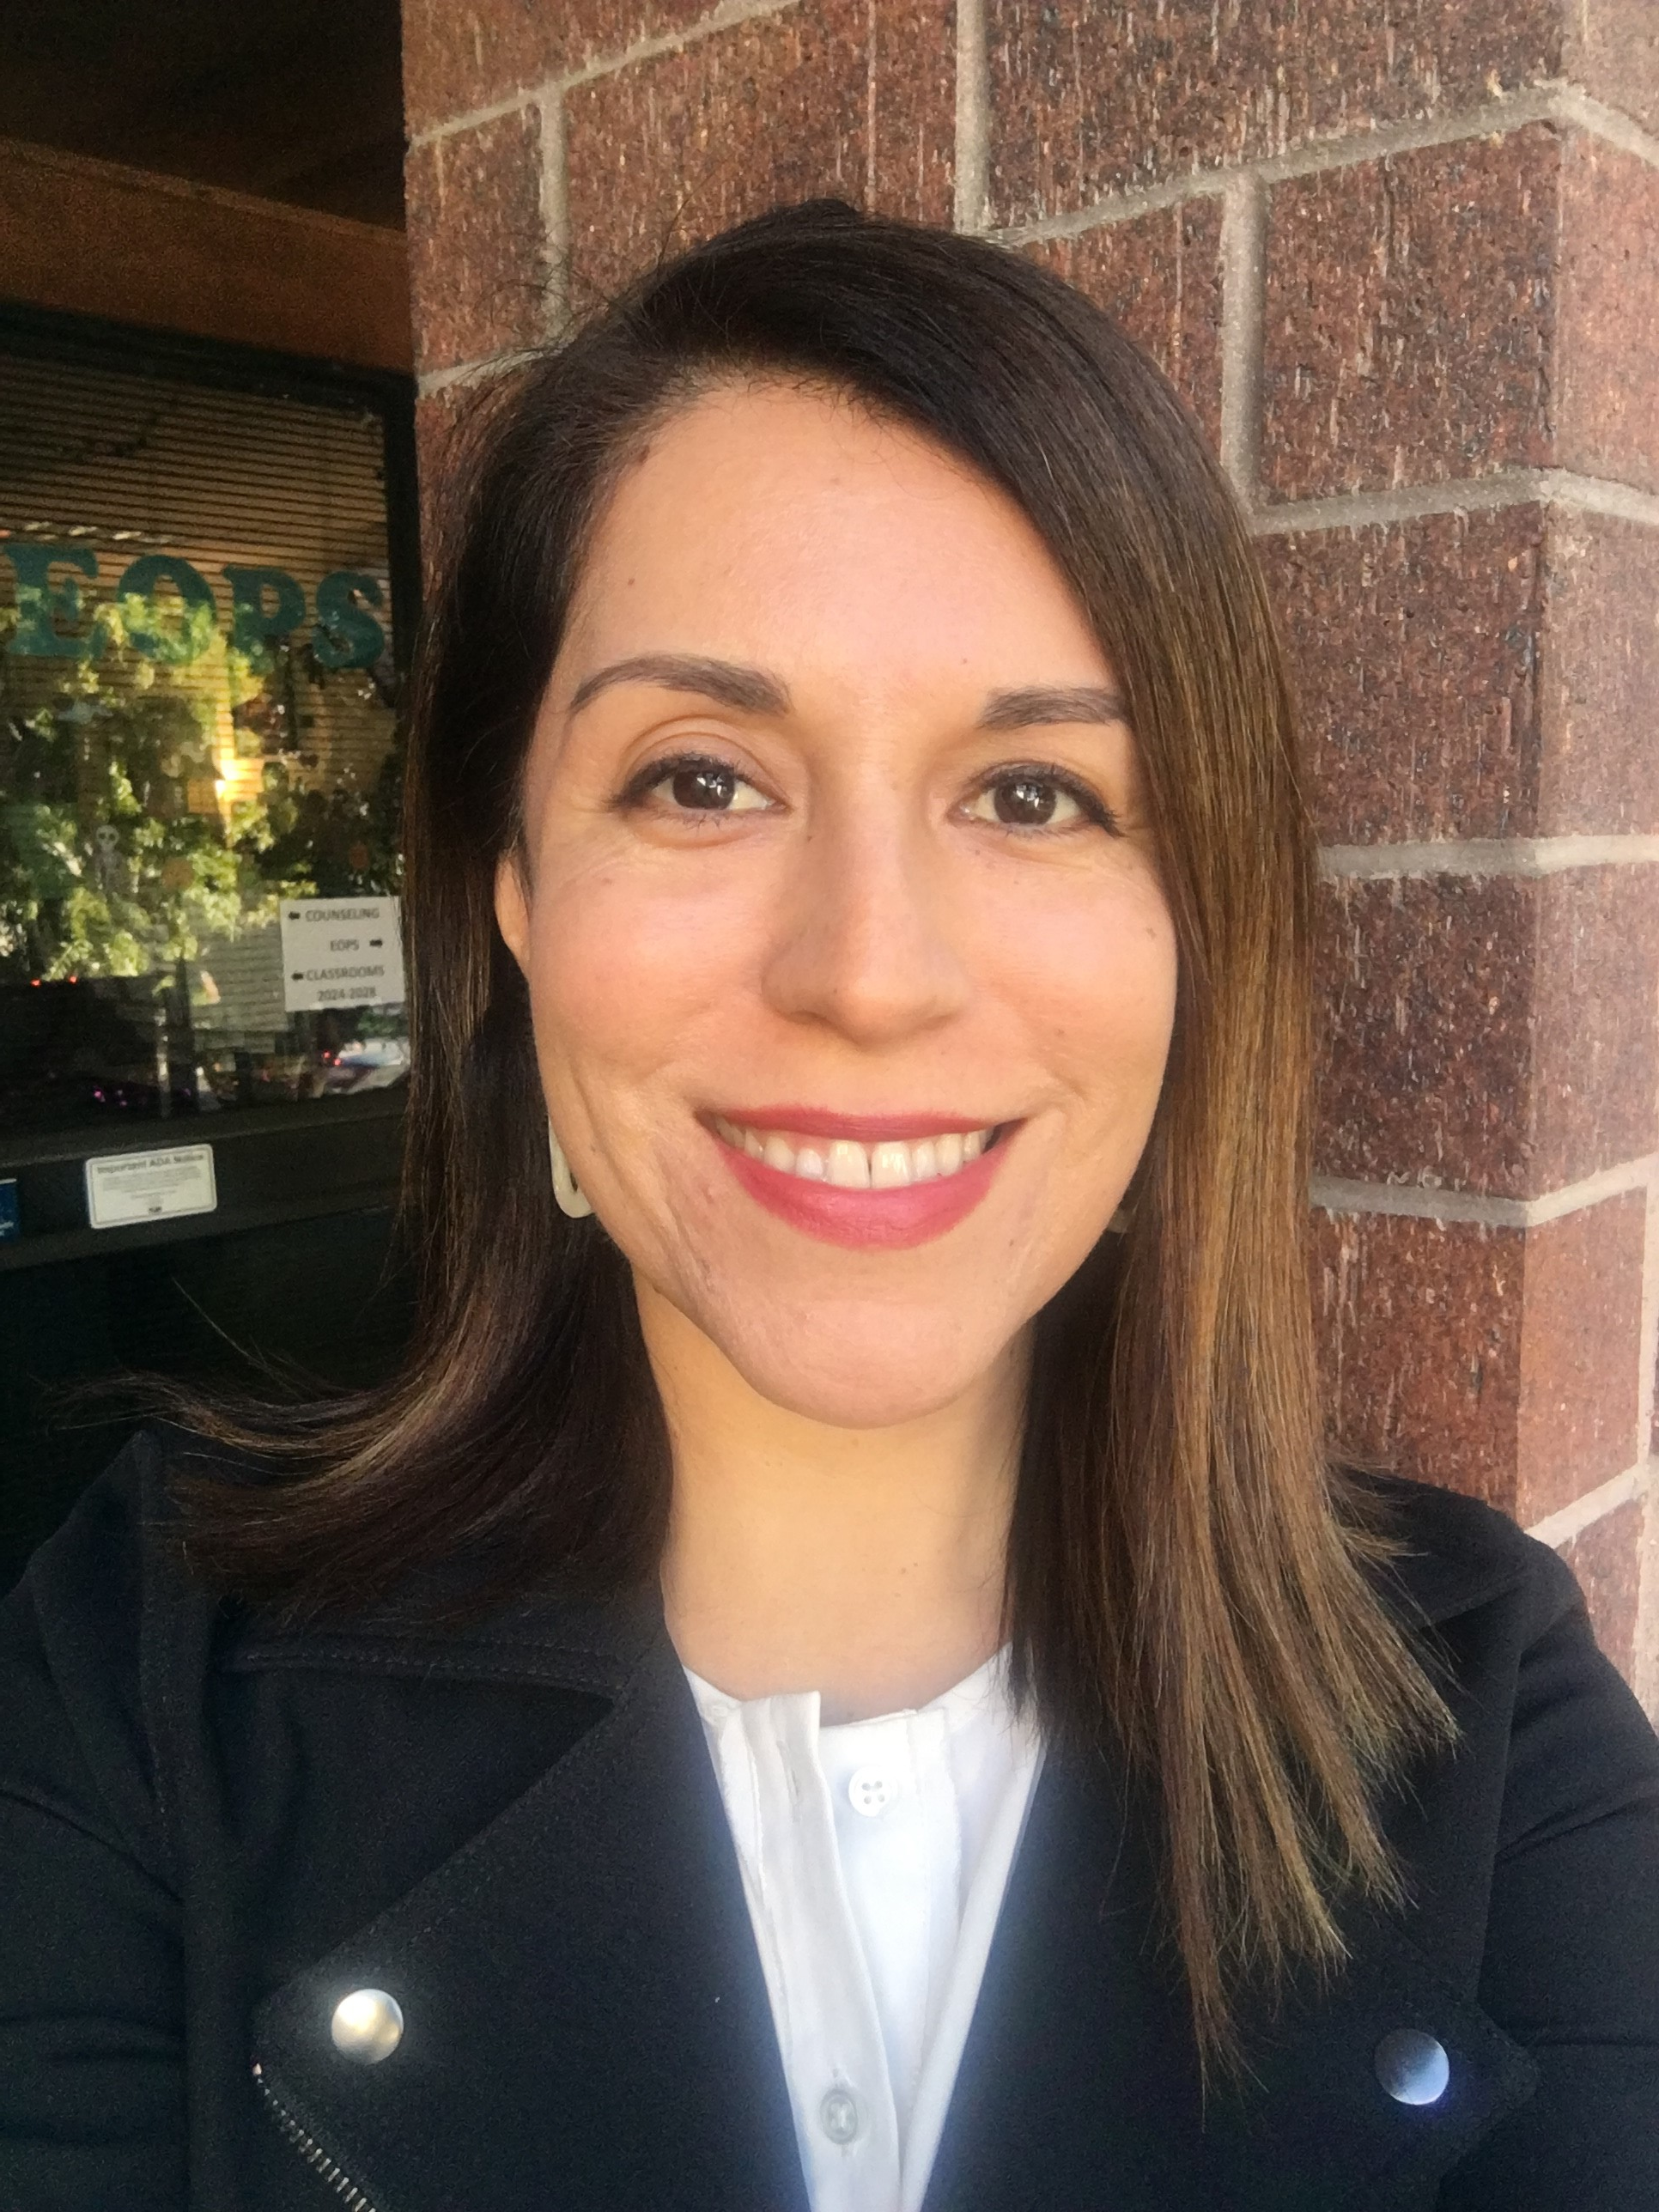
Educational Planning
Career Education Counselors
Olivia Barajas, M.S.
Jennika Celo, M.S.
Pamela Skiles, M.S.
NOTICE: All counselors provide “counseling for Paralegal Studies students” as part of your educational planning. Thus, there is no difference between the Career Education Counselors and those in other departments (Counseling Center, EOPS, etc.)

Slide 7
Educational Planning
Remote Counseling Services
https://vpss.fullcoll.edu/counseling-remote/
For an appointment call the Counseling Center:
(714) 992-7084 (Dial 1, then 8)
Appointments can also be made using the “Ask Us” Chat on the Counseling Center Website
Non-peak periods: Feb, March, Sept and Oct.
Fall 2020 Hours:
Monday, Thursday and Friday 8 a.m. to 5 p.m.
Tuesday and Wednesday 8 a.m. to 7 p.m.
Selected Saturdays 9 a.m. to 2 p.m.

Slide 8
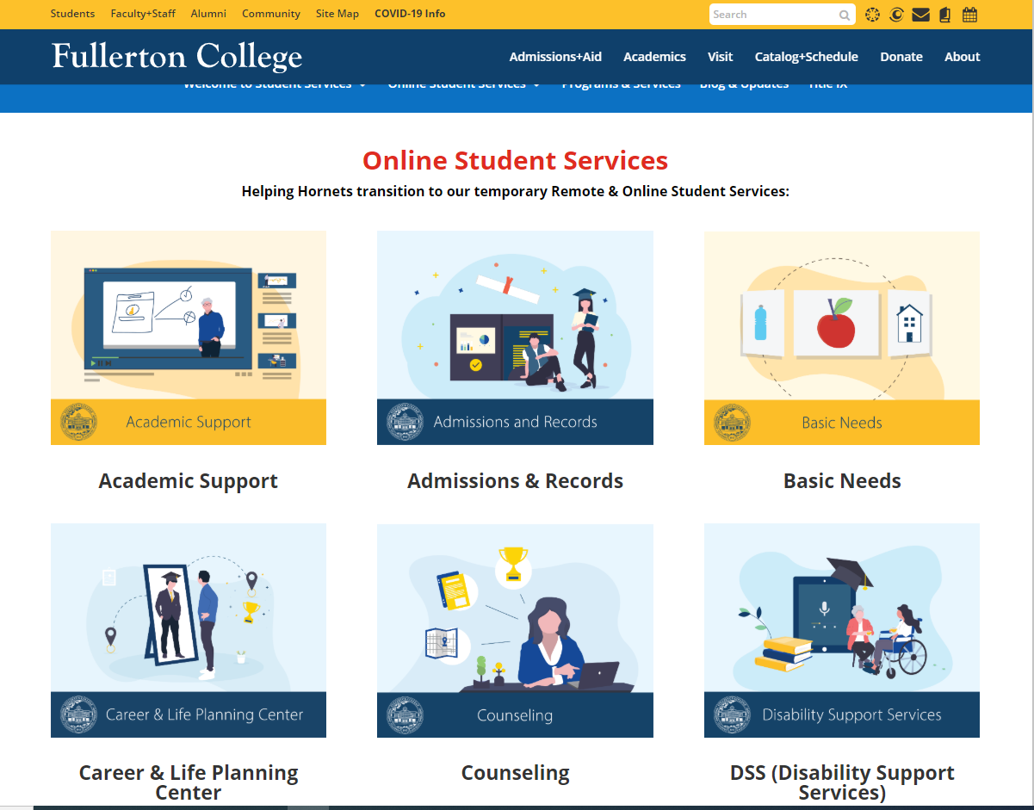
Remote/
Online Student Services Website https://vpss.fullcoll.edu/student-services-remote/

Slide 9
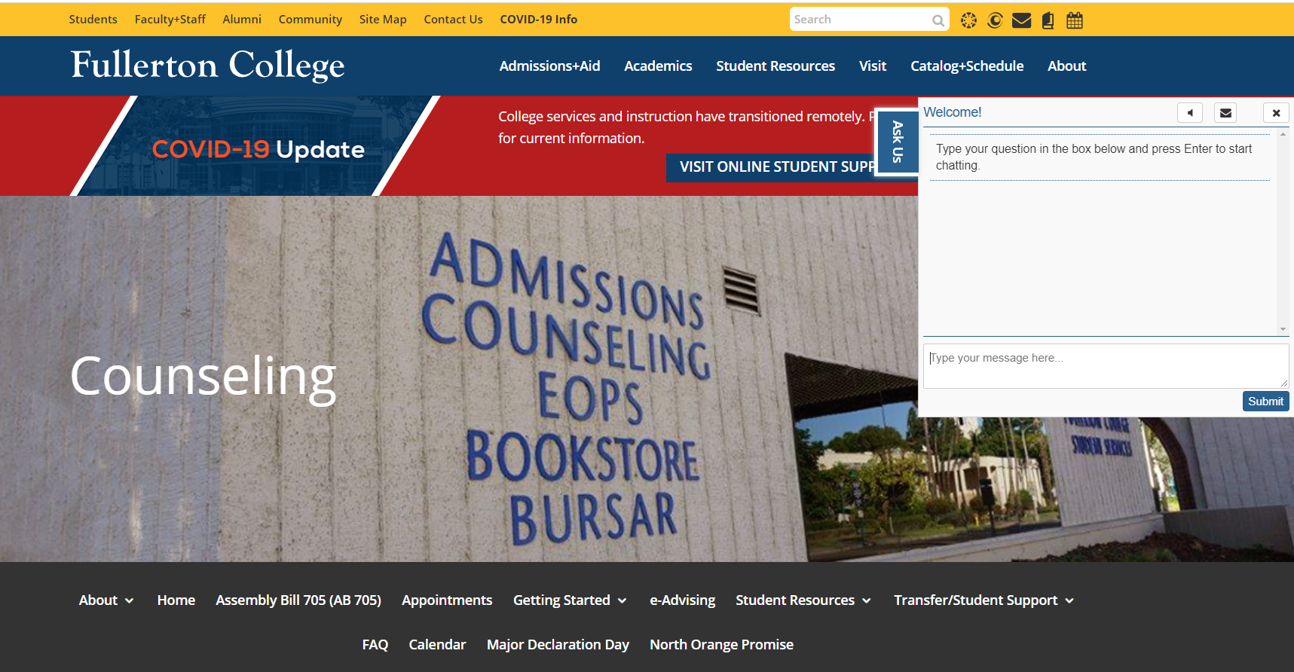
New Chat Feature https://counseling.fullcoll.edu/

Slide 10
  A.S. to B.S. Articulation Pathways
Plan for the Next Step in your Education:
University of La Verne
  B. S. in Legal Studies
  Live Q & A on Thursday, Sept. 3rd
  at 5:30 pm
National University
  B. S. in Paralegal Studies
  Live Q & A on Thursday, Sept. 10th
  at 5:30 pm

Slide 11
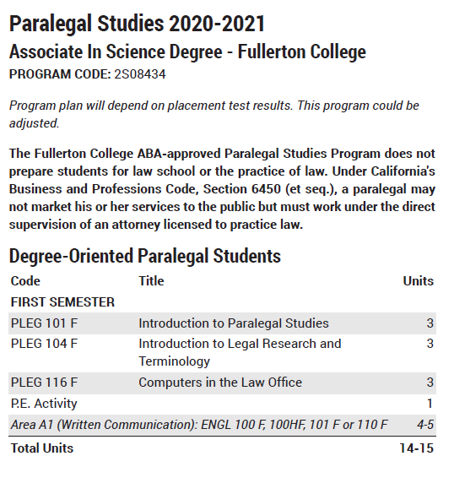
Course Information:
(See suggested sequences)
What do I take?

Slide 12
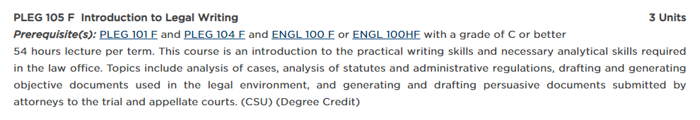
Course Information
(See Catalog)
Prerequisites Required for
Select Courses
Example:

Slide 13
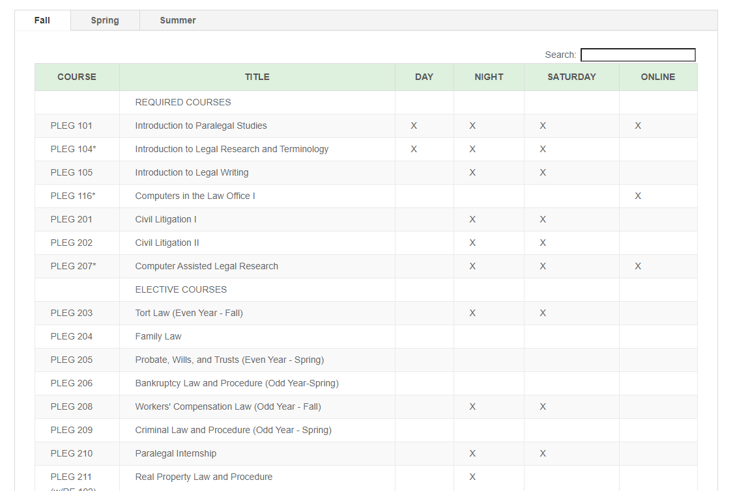
Course Information
Program Website: “Projected Course Rotation” https://buscis.fullcoll.edu/paralegal/
Schedule of Classes: https://www.fullcoll.edu/schedule/
When are courses offered?

Slide 14
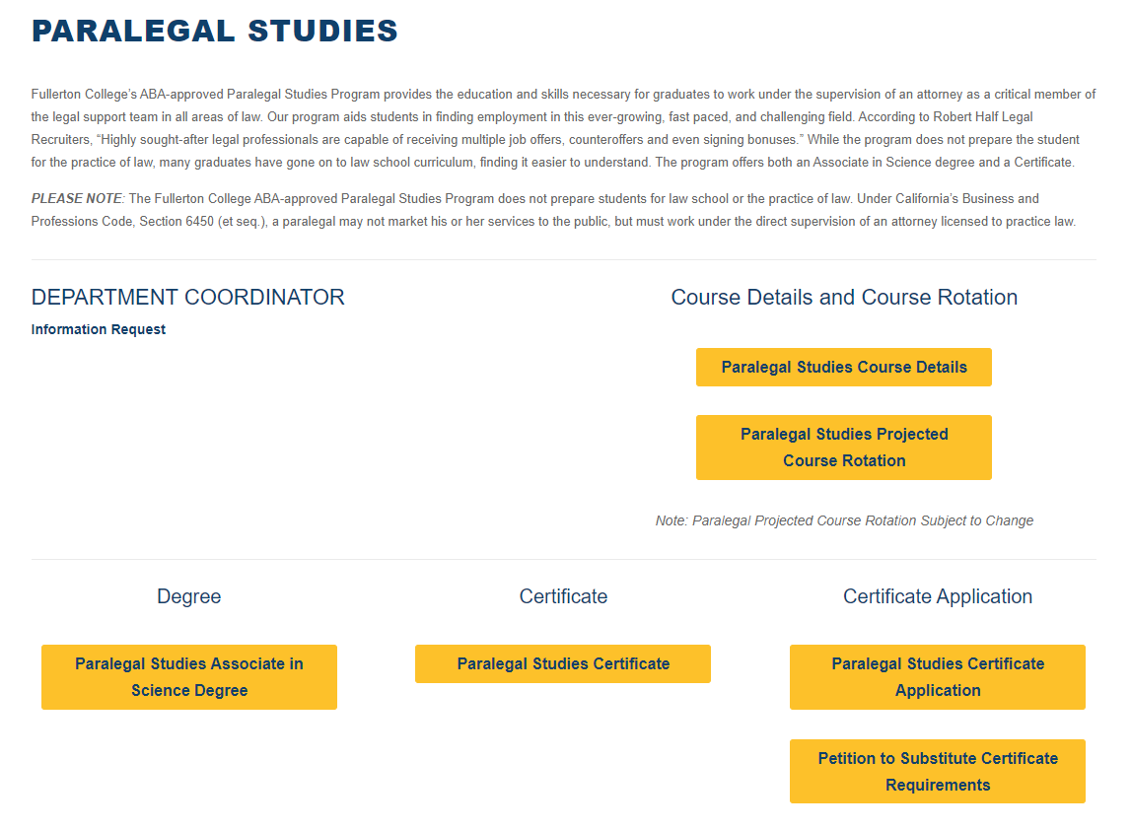
Course Information:
Program Website https://buscis.fullcoll.edu/paralegal/
Paralegal Studies Program Website

Slide 15
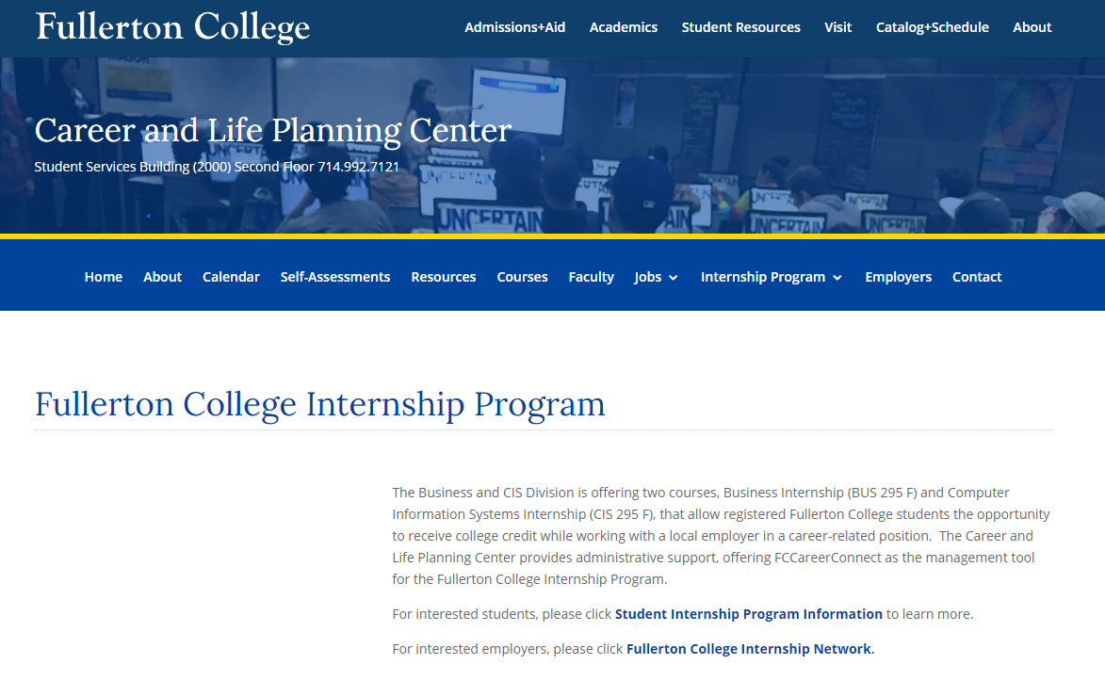
Work Experience:
Internship
Opportunities
https://careercenter.fullcoll.edu/internships/

Slide 16
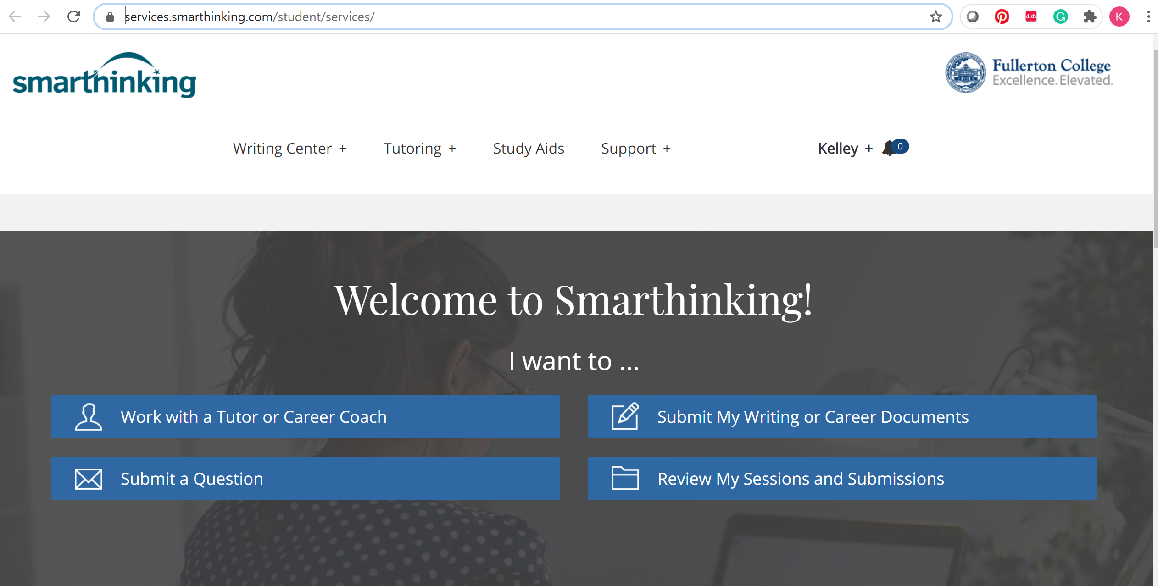
Smarthinking
Online
Tutoring
Via Canvas or
FC website:
https://academicsupport.fullcoll.edu/smarthinking/

Slide 17
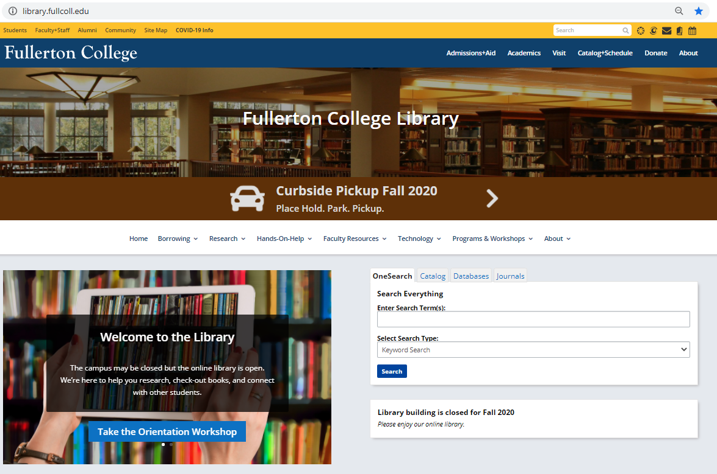
Library
Resources

Slide 18
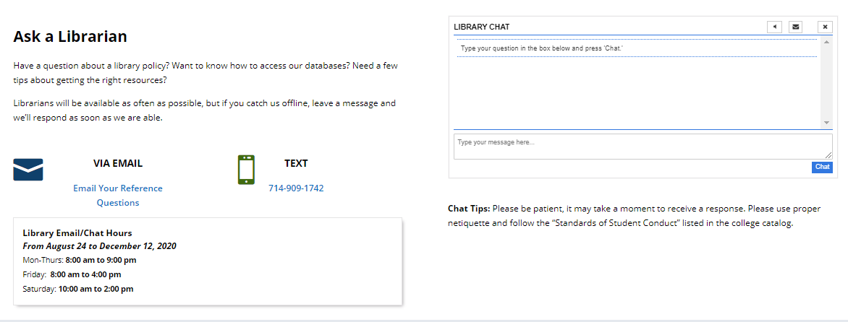
Library
Resources

Slide 19
American Bar Association (ABA):
http://www.americanbar.org/groups/paralegals.html
California Alliance of Paralegal Associations (CAPA):
http://www.caparalegal.org
National Association of Legal Assistants (NALA):
http://www.nala.org
Orange County Paralegal Association (OCPA):
www.ocparalegal.org/
Los Angeles Paralegal Association (LAPA):
http://www.lapa.org/
Inland Counties Association of Paralegals (ICAP):
http://www.icaponline.org
Paralegal
Professional
Organizations

Slide 20
Orange County Paralegal Association $500 x two
Los Angeles Paralegal Association $1,000
Buckfire Law Firm $1,000
Application information available on program Canvas course
or by email to: kjoneshorwood@fullcoll.edu
Scholarship
Opportunities

Slide 21

LAMBDA EPSILON CHI (LEX)
National Honor Society in Paralegal Studies
Lambda Epsilon Chi (LEX) is a national honor society established to recognize students who demonstrate superior academic performance in an established program of paralegal and law-related studies. LEX derives from the Latin root meaning “pertaining to the law” or “legal.”
Students in the Fullerton College Paralegal Studies Program qualify for membership if they:
  Have completed two-thirds of their required coursework; and
  Have a cumulative G.P.A. of 3.25 in their required coursework.
LEX
National
Honor
Society

Slide 22
Program
Administration
Contacts

